Slide 1

CRIME ANALYSIS OF CHARLOTTE, NC
FINAL PROJECT: UNCC DATA ANALYTICS BOOTCAMP
Kimberly Cavazos, Brenton Ervin, Ryan Marshall, Fiston Rugwiro
Notes:
Each person gives a brief introduction to themselves and their background.

Slide 2
TOPIC DISCUSSION
The purpose of this analysis is to look at crime in Charlotte, NC
Create a Model that uses violent crime data and tries to predict the frequency of crimes occurring during a specified time period.

Slide 3
QUESTIONS WE PLANNED TO ANSWER
Is Charlotte a safe place to live?
Where is the safest area of Charlotte per the crime data?
Can we predict the frequency of crimes committed per month in Charlotte?

Slide 4
HOW ARE WE GOING TO ANSWER THESE QUESTIONS?
OBTAIN DATA FROM REPUTABLE SOURCES
ETL PROCESS
CREATE MACHINE LEARNING MODEL
DATA VISUALIZATIONS TO TELL THE STORY

Slide 5
EXTRACT
Gather and Download Credible Data (CMPD)
Inspect all data
TRANSFORM
Convert Data Types
Drop Null Values
Transform Data Types
Join Tables
Export as Clean CSVs
LOAD
Use clean data for visualizations and Machine Learning model
Create Database in Postgress

Slide 6
ETL PROCESS/ DATA SOURCES
Gathered Data
Inspected all Data in Python
Convert Data Types
Export as Clean CSV’s
Import Data from cleaned CSV’s
Export Table as CSV
Create Machine Learning Model
Create Database in Postgress
Create Visualizations
Notes:
Fiston & Brenton: Discuss the process. Make sure to discuss that we created the database but did not actually use it for the Machine Learning piece.

Slide 7
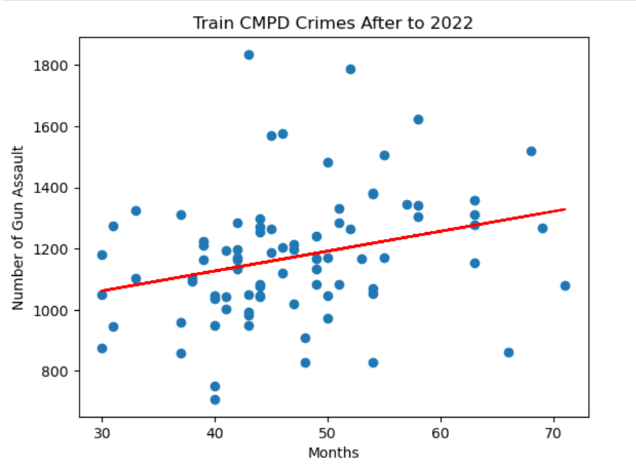
MACHINE LEARNING MODEL
Linear Regression Model
What we wanted to do… Predict frequency of crime per month.
We are now using a linear regression model to predict the frequency of violent crimes with a gun occurring per month.
LESSONS LEARNED:
Linear Regression model does not work for this data.
Scary note: gun violence was the only point that made sense!
Total of Incidents per Month
Data Timeline
Notes:
Ryan: Discuss the machine learning model and process. Problems encountered. Why we picked this.

Slide 8
VISUALIZATIONS
INTERACTIVE DASHBOARD
Notes:
Kim

Slide 9
SUMMARY
According to the Heat map, the northern part (Huntersville) of the county would be the safest place for the client and family.
University City area seems to have the most crime.
Based on our analysis, we feel that the Charlotte area could be a safe enough place for our client.
There were approximately 880 thousand people living in Charlotte in 2021.
In 2021, __% of citizens were involved in a violent incident.
This number seems relatively low compared to the population size
We hoped to use our Machine Learning Model to show the frequency of crimes occurring per month to predict the likelihood of a crime occurring in a specific time period.
Our model did not work for this and therefore we can not confidently provide that information.

Slide 10
DISCUSSION
Roadblocks
What we would do if we had more time
Visualizations based on Machine Learning Model results
QUESTIONS???

